Slide 1


BEGINNER PROGRAMMING LESSON
EV3 Classroom: Moving Straight

Slide 2
Lesson Objectives
Learn how to make your robot go forward and backwards
Learn how to use the Move Steering block
Learn how to read sensor values using Port View

Slide 3
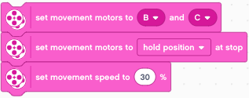
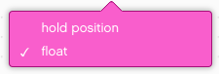
Configuring Movement Blocks
Before using movement blocks, you must configure the robot first.
There are three blocks for this purpose:
This one determines which motors are connected to the left & right wheels
This determines what the robot doesat the end of a move block (brake/hold or float/coast)
This sets the “default” speed for later move blocks
B
C

Slide 4

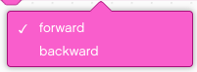
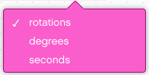
Move Straight Block
Set in configuration
B
C
Power/Speed
Brake/Coast
Direction
Mode of operation
Duration/Distance
Simplest move block – just gives control over direction and distance
Other move blocks give control over speed and steering

Slide 5

Move Steering Block
Set in configuration
B
C
Steering
Power/Speed
Brake/Coast
Mode of operation
Duration/Distance
This gives control over steering by giving different amounts of power to the left and right wheels. 50 & -50 steering give 0 power to one wheel and full power to the other. 100 and -100 give full power to both wheels but turn them in opposite directions

Slide 6

Move Steering/Power Block
Set in configuration
B
C
Steering
Mode of operation
Brake/Coast
Duration/Distance
Move Speed
This is like the move steering block. However instead of using the configured “default” speed, you specify the speed within the block. This is useful if you have one move that you want to do more slowly or quickly.

Slide 7
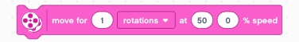
Move Tank Block
Set in configuration
B
C
Duration/Distance
Brake/Coast
Mode of operation
Left and Right
Wheel Speeds
This is like the move steering/speed block. However instead of specifying speed and steering, you specify the two motor speeds independently. Its behavior will be identical to the steering/speed block.

Slide 8
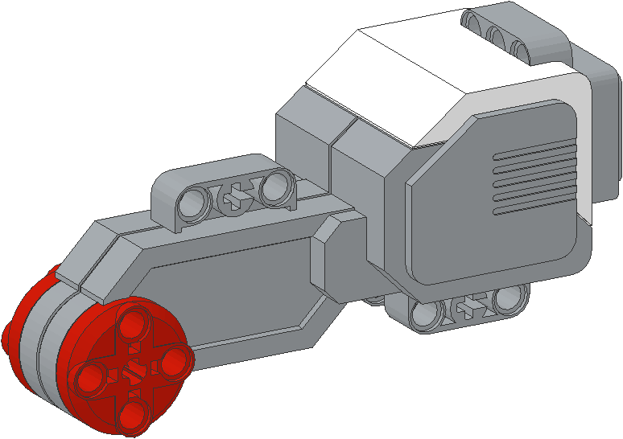
NEGATIVE Values
Negative Power = Backwards
Positive Power = Forward
You can enter negative values for power or distance
This will make the robot move backwards
If you negate two values (e.g. power and distance or distance and backwards direction), the robot will move forward.

Slide 9
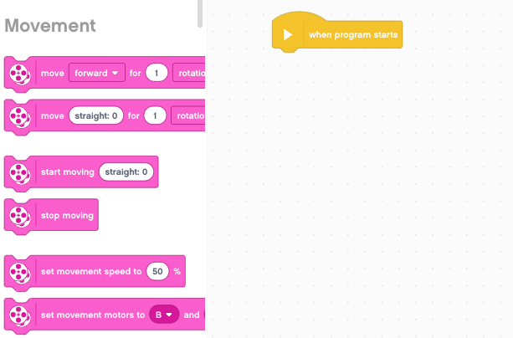
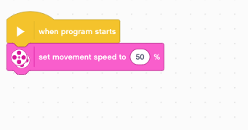
How To Make a Program
STEP 1: Click and hold Set Speed block and drag to programming area
STEP 2: Drop next to the Start Block (green arrow) (See animation)

Slide 10
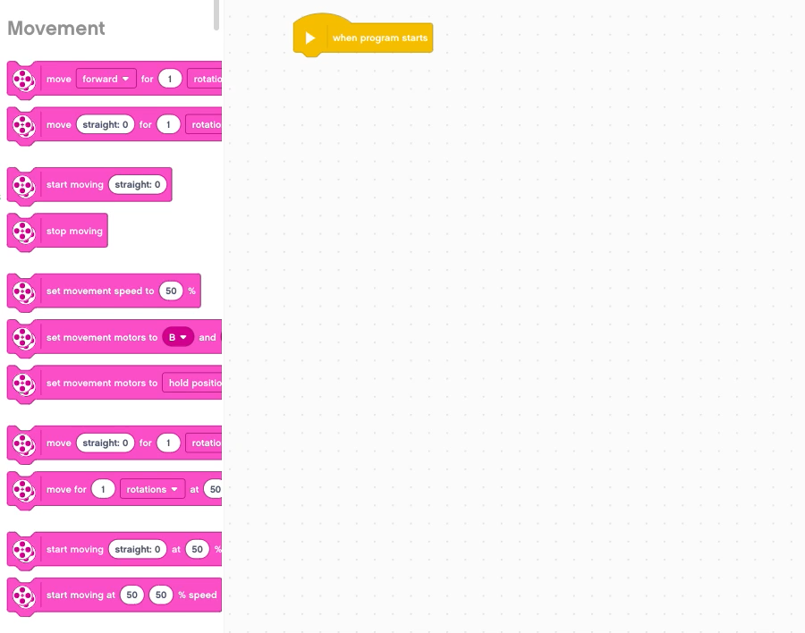
Making a Move Straight Program
STEP 3: Drag the remaining “configure movement” blocks to the program
STEP 4: Drag the Move Straight block onto the program
(see animation)

Slide 11


CHALLENGE 1: Move Straight (3 SECONDS)
Step 2:
STEP 1: Create a Move Straight program
STEP 2: Change mode and duration. Move “3 Seconds”
STEP 3: Connect USB cable to EV3 and Laptop.
STEP 4: Download to EV3
Step 3
Step 4

Slide 12
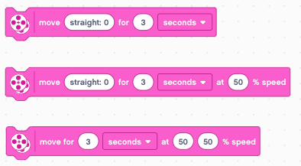
Other Ways to Move 3 Seconds
Scratch gives you different ways to move 3 seconds.
Here are 3 other blocks that will move you 3 seconds

Slide 13
Teacher instructions
Split up class into groups as need
Give each team a copy of the Move Straight Challenge Worksheet
Challenge Details are on Slide 8
Discussion Page Slide 9
Challenge Solution on Slide 10
A Better Way on Slide 11

Slide 14
Move Straight: Seconds vs. degrees vs. rotations
FINISH
CHALLENGE: Move your robot forward from the start line to the finish line (1) and back to the start (2).
Try mode SECONDS, DEGREES or ROTATIONS and adjust duration/distance
Try different speeds
1
2
B
START
C

Slide 15
MOVE STRAIGHT discussion
Did you guess and check a lot?
Yes. Programming with seconds, rotations and degrees using guess and check takes a lot of time and effort.
Did changing the speed matter?
Yes. When you move in seconds your speed will matter.
Do you think the wheel size will matter? Why?
Wheel size affects degrees/rotations.
Do you this the battery level will matter? Why?
When you move in seconds, battery levels change the power.

Slide 16
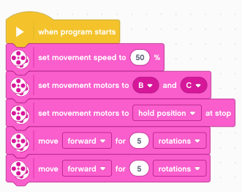
CHALLENGE SOLUTION
This would be changed for degrees or seconds
There is a better way (go to slide 11) to solve this challenge

Slide 17
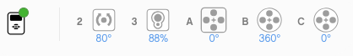
SOLUTION: USE PORT VIEW
CHALLENGE: Move your robot forward from the start line to the finish line (1) and back to the start (2).
In this lesson, you had to use a lot of guess and check to stop exactly on the second line.
Now try Port View:
Go to one of the rotation sensors (Motor B or C for our robot on the right)
Make sure it is on degrees as the mode and that it starts at 0 degrees.
Move your robot with your hand from the start line to the end line. Make sure that your wheel turns smoothly and doesn’t slip as the robot moves.
Read how many degrees your robot moved
Use this number in the Move Steering Block to move the correct distance.
Read the lesson on Port View for more information
FINISH
2
1
START
B
C

Slide 18




Start Moving and Stop Moving Blocks
There are 4 more move blocks in the Movement palette.
The Start moving blocks will turn on your drive motors at the given speed (and steering if given).
These blocks have no duration/distance. After turning the motor on, the program instantly moves to the next block
The motor will continue running until stopped or controlled by another block
Stop moving will halt your drive motors no matter what action they are running.

Slide 19
Start and stop Moving
What would happen if you placed a Start Moving block?
Would the robot…
1) Move?
2) Move for a little while?
3) Not move at all?
ANS. Move until stopped or the program ends. Note that the program will not end unless you have a Stop Program block.
What does Motor Off do?
ANS. Turn off the motors.
Note that this is a different behavior than EV3-G users might be familiar with.

Slide 20

Wait Block
Start and Stop Moving blocks are typically used along with wait blocks. Wait blocks hold up the program execution until some event occurs. The lessons on sensors cover wait blocks in more detail.
For now, we will use the Wait for Seconds block
This block takes the entered number of seconds to run
Can you solve Challenge 1 (Move 3 Seconds) using Start Move and Wait blocks?

Slide 21
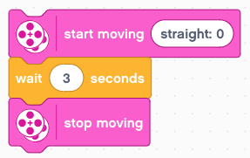
Other Ways to Move 3 Seconds
The Start Moving block starts the robot moving
After turning on the motors, the program begins running the Wait block. This takes 3 seconds to run.
The Stop Moving block makes the robot stop

Slide 22
CREDITS
This tutorial was created by Sanjay Seshan and Arvind Seshan
More lessons are available at www.ev3lessons.com
This work is licensed under a Creative Commons Attribution-NonCommercial-ShareAlike 4.0 International License.

